Slide 1





INNOHACK 2.0
TITLE PAGE
TRACK NAME HERE
Digi-Tech
PROBLEM STATEMENT
Gamified E-Learning Platform for STEM and Coding Education
TEAM NAME HERE
Cockroach Tech Team
MEMBER'S NAME WITH REGISTRATION NUMBER
Sakcham Pasari — 25BCE2257
Daksh Sabarwal — 25BCE2318
Suvansh Choudhary — 25BAI0252

Slide 2
INNOHACK 2.0
PROBLEM STATEMENT
DEFINE YOUR PROBLEM STATEMENT
Design a gamified e-learning platform that teaches STEM and coding concepts through interactive gameplay for school and college students.
Why it matters: Students cannot consistently commit to learning coding and give up midway — especially in self-paced environments where there is no accountability, no competition, and no visible progress.
IMPORTANCE / RELEVANCE
Traditional coding courses are linear, passive, and isolating — no real-time feedback loop.
Students lack a measurable sense of achievement or peer comparison.
The gap between “learning” and “applying” knowledge is never bridged in conventional EdTech.
Coding platforms like LeetCode are too intimidating for beginners with no guided progression.
Who is affected: school students (grades 8–12), college CS students struggling with DSA, and career switchers needing structured, competitive learning.
(OPTIONAL) SUPPORTING STATISTIC EXAMPLES
85–95% of self-paced online learners quit DSA courses midway — Industry research
40–70% dropout/failure rate in university-level DSA courses — Academic studies
Only ~6% of online course enrollees ever reach completion — MOOCs aggregate data
Gamified learning increases engagement by up to 60% and retention by 40% — Gamification research

Slide 3
INNOHACK 2.0
PROPOSED SOLUTION
OUTLINE YOUR IDEA / SOLUTION
Codingo — a desktop e-learning application that turns coding education into a competitive game, complete with ranked battles, skill-based matchmaking, levelled progression maps, and a live leaderboard.
HOW DOES IT SOLVE THE PROBLEM?
Passive video lessons → Interactive problem nodes on a game map
No real-time competition → Live 1v1 ranked duels
Raw scores with no context → Percentile-based rank tiers (Bronze → Grandmaster)
One-size-fits-all difficulty → Skill-matched opponents via Glicko-2 MMR
Drop-off after a few weeks → Seasons, streaks, and rank-defense motivation
WHAT MAKES IT INNOVATIVE?
Fair Glicko-2 MMR matchmaking, an inflation-proof percentile-based leaderboard, and two real-engineering game modes — Debug Duel and 1-Shot Vibecode Duel — that test genuine debugging and planning skill, not just puzzle-solving speed.

Slide 4
INNOHACK 2.0
TECHNICAL APPROACH
TOOLS, TECHNOLOGIES OR COMPONENTS USED
WORKFLOW / ARCHITECTURE DIAGRAM
Desktop Client | Electron + React + TypeScript
Game Maps | Phaser 3 (2D game engine)
Code Editor | Monaco Editor (VS Code's editor)
State Management | Zustand
Backend | NestJS (Node.js, modular monolith)
Realtime Duels | WebSocket (server-authoritative)
Database | PostgreSQL + Redis
Code Judge | Remote sandboxed containers (gVisor)
Practice Sandbox | Local WASM (offline-capable)
Rating System | Glicko-2 algorithm (server-side only)
Sign Up → Placement Duels (5) → Rank Assigned → Choose Level (1–5) → Explore Map → Solve Nodes (Practice) → Unlock Ranked Queue → Queue Up → Matched Opponent Found → Choose Mode: Debug / Vibecode Duel → Solve → Submit → Server Judges → Rating Updates → Leaderboard Refreshes
IMPLEMENTATION DETAILS
Architecture principle: the server is the sole authority on correctness, timing, and rating — the client is a rich display layer, never a source of truth.
Five themed learning maps — Syntax Sands → Logic Lagoon → Structure Steppes → Algorithm Ascent → Architect's Apex — with server-saved progress and offline browser-sandbox practice.

Slide 5
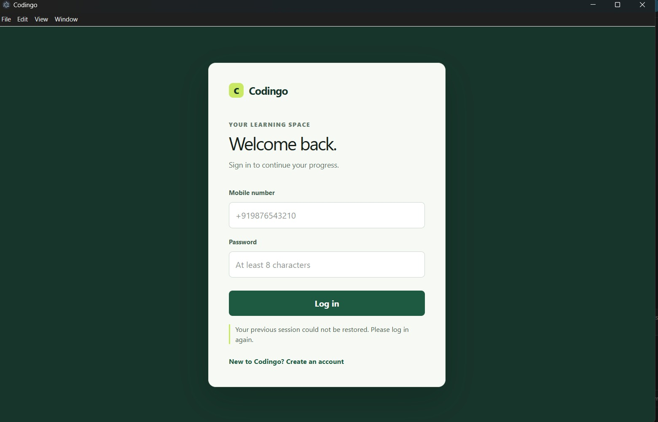
INNOHACK 2.0
DEMO / PROTOTYPE
SHOWCASE THE WORKING PROTOTYPE (IF AVAILABLE)
Codingo desktop client — login screen shown at right (clean green/cream branded UI).
SCREENSHOTS OR DEMO VIDEOS
Screenshot attached: Codingo — Login Screen (“Your learning space — Welcome back.”)
KEY FEATURES
Login screen (shown)
Level map screen (game world node graph)
Duel editor screen (Monaco editor + opponent progress signal)
Leaderboard screen (rank tiers + percentile display)

Slide 6
INNOHACK 2.0
IMPACT & USE CASES
WHO BENEFITS FROM YOUR SOLUTION?
Persona | How Codingo helps
School student (Class 10–12) | Starts at Level 1 (Syntax Sands), builds confidence through guided map progression before competition
CS college student | Uses ranked duels for exam and placement prep; measurable DSA skill shown via tier rank
Career switcher | Structured map with clear prerequisites; offline practice available anytime
Competitive programmer | Ranked ladder, seasonal resets, and Grandmaster-tier challenges
HOW CAN IT BE APPLIED IN REAL WORLD SCENARIOS?
Guided map progression builds confidence for beginners; ranked duels give college students measurable, placement-ready proof of DSA skill; competitive programmers get a ranked ladder with seasonal resets and Grandmaster-tier challenges.
SCALING / SUSTAINABILITY
Fair Glicko-2 matchmaking protects retention — students are never crushed by a far stronger opponent — while the inflation-proof percentile leaderboard and offline-capable practice sandbox keep engagement sustainable as the user base grows.

Slide 7
INNOHACK 2.0
CHALLENGES FACED
MENTION OBSTACLES DURING DEVELOPMENT
Implementing real-time multiplayer support and ranking leaderboards while maintaining fair matchmaking will be a big challenge for us.
SHOW PROBLEM-SOLVING ABILITY
Server-authoritative WebSocket architecture keeps every duel's state, timing, and outcome validated on the backend, preventing client-side manipulation in real-time matches.
Glicko-2 rating algorithm pairs players of similar skill and updates ranks after every duel, keeping matchmaking fair as the player base grows.
Matchmaking queue widens progressively over time, balancing fair skill gaps against reasonable wait times.
Percentile-based leaderboard tiers recompute against the live population, keeping ranks accurate and inflation-proof as more students join.

Slide 8
INNOHACK 2.0
FUTURE SCOPE
FUTURE SCALABILITY (DEVELOPMENT BASED)
Team battles (3v3, FFA modes)
Mobile client (iOS/Android)
Live tournament brackets with spectating
AI-powered hint system for stuck learners (non-duel mode only)
LONG – TERM VISION
Community problem marketplace — educators author problems, students solve them
Institution dashboards — schools/colleges track student progress cohort-wide
Cosmetic rewards — avatars, map skins, and profile badges to reinforce identity

Slide 9
INNOHACK 2.0
CONCLUSION
SUMMARIZE THE SOLUTION
Codingo turns coding education into a competitive game — ranked duels, skill-matched opponents, and a live leaderboard replace passive video lessons, giving students visible progress and the motivation to keep going.
NOVELTY
Fair Glicko-2 MMR matchmaking, an inflation-proof percentile leaderboard, and real-world skill modes — Debug Duels and 1-Shot Vibecode Duels — set Codingo apart from conventional, passive EdTech platforms.

Slide 10
INNOHACK 2.0
ACKNOWLEDGEMENTS
CREDIT TEAM MEMBERS, REFERENCES AND MENTORS
Name | Registration
Sakcham Pasari | 25BCE2257
Daksh Sabarwal | 25BCE2318
Suvansh Choudhary | 25BAI0252
Team Name: Cockroach Tech Team

